Slide 1

Time Series forecast of NZ visitor arrivals to Australia
Name: Saadman Ahmed Saad
Student ID : 10660130, Date :

Slide 2
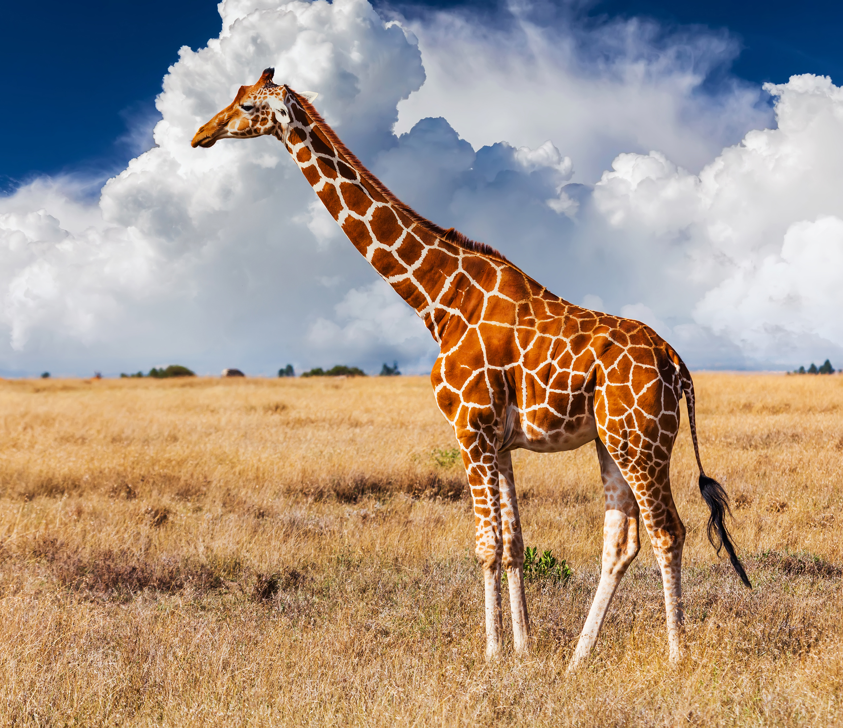
Introduction
International tourism is a vital sector for Australia’s economy
Accurate forecasting helps in tourism planning and resource management
This project focuses on monthly visitor arrivals from New Zealand to Australia ( Jan 1991 – Mar 2025).
The data visually shows strong seasonality along with an upward trend
The aim is to develop a time series model to forecast future visitor numbers from 2026 to 2028

Slide 3
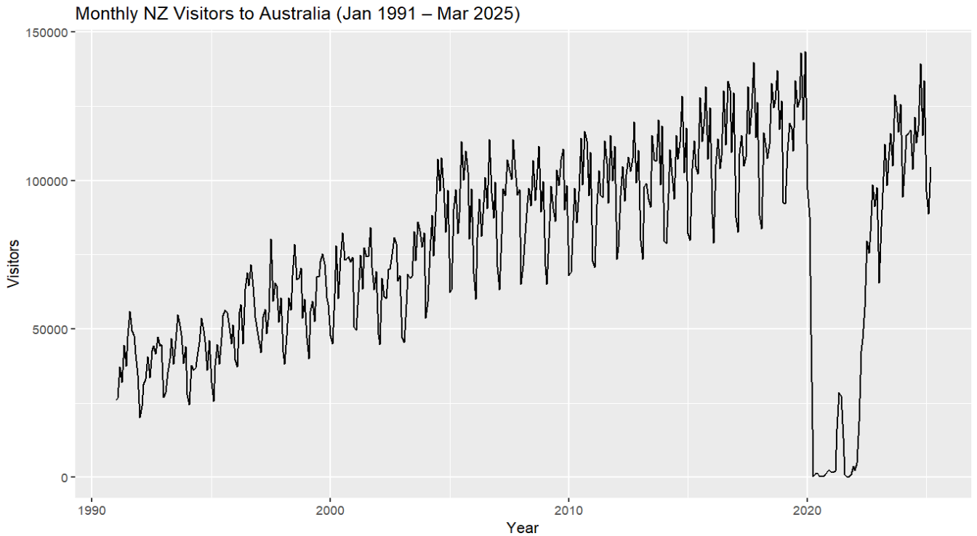
Increasing variance
Strong seasonality
Upward trend
Steep drop due to covid-19 restrictions

Slide 4

Objective
T Forecast model that captures the trend and seasonality and generate accurate predictions for the next three years

Slide 5
Methodology ( Slide 1)
Data of New Zealand visitors to Australia was collected from Australian Bureue of Investigation.
After analyzing the monthly data from 1991 – 2025 sarima was chosen as our tool to forecast the future.
Logarithmic transformation to deal with the increasing variance
Transformed data already showed it was stationary from ADF test first-order differencing was ignored.
The data had strong seasonality visually therefore seasonal differencing was performed.
ADF test after differencing had a p-value of 0.01

Slide 6
Methodology Slide 2
ACF and PACF curve revealed seasonal patterns along with a sinusoidal behaviour in the ACF curve
Sarima models where (p,0,q)(P,1,Q) with different combinations where modelled to find the best model. Where d=0, due to no first order differenecing and D=1,due seasonal differencing was implemented
Best model was chosen with the least AIC and BIC scores
Residual diagnostics was unsatisfying revealing significant auto correlation with non-normal data distribution.
Sarima model (1,0,1)(0,1,1)[12] was the best according to AIC and BIC scores.
Forecasting 36 months ahead (2026-2028)

Slide 7
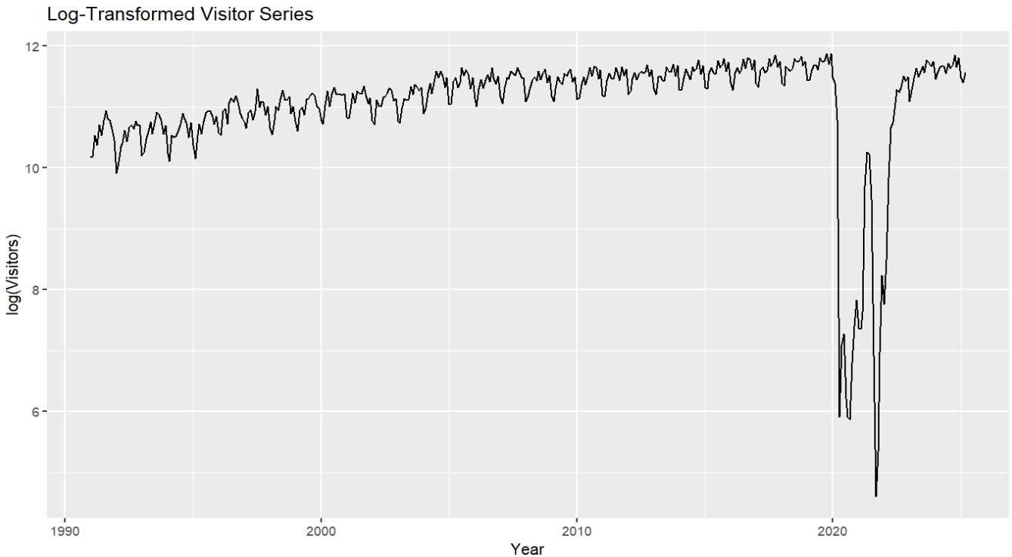

Slide 8
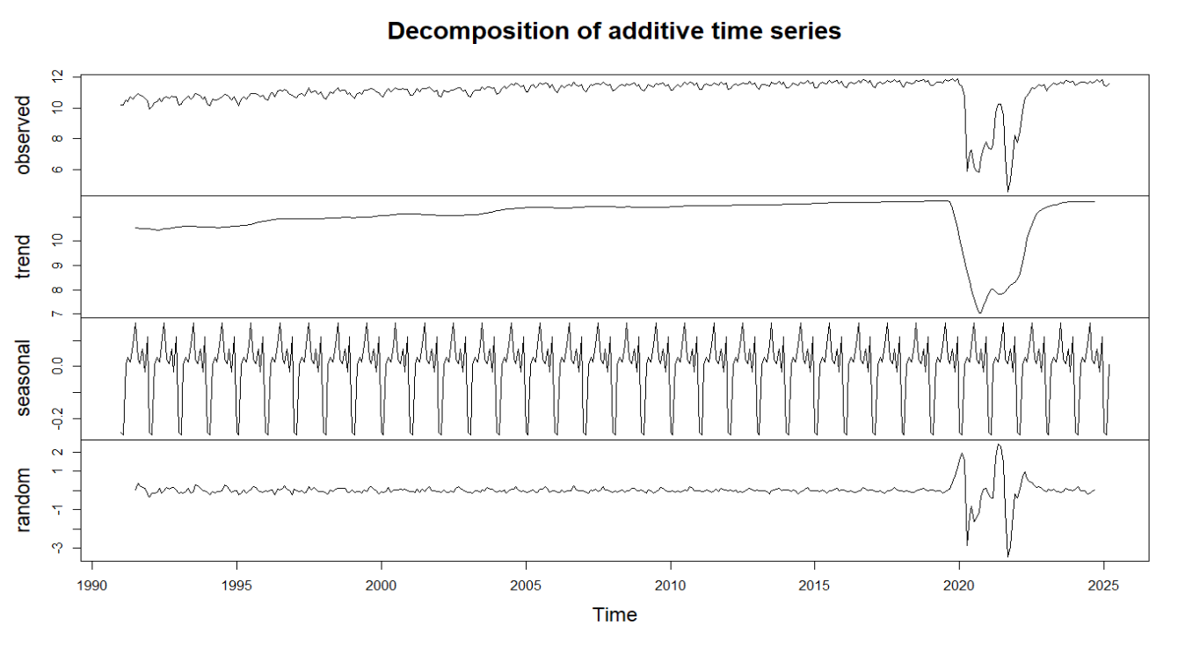

Slide 9
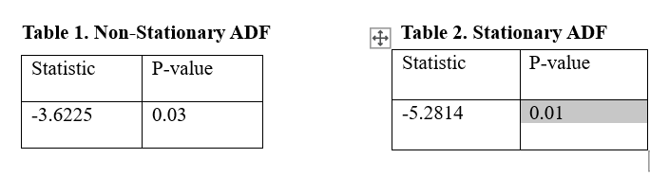
Before seasonal differencing
After seasonal differencing

Slide 10
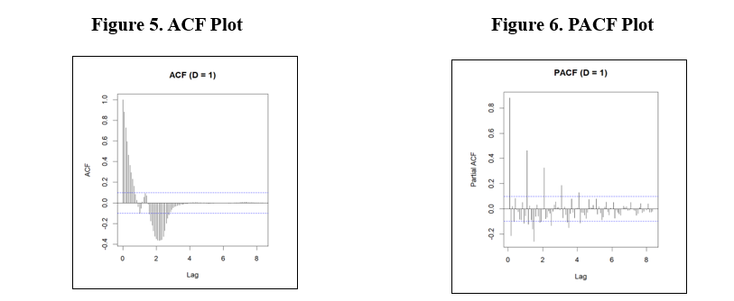

Slide 11
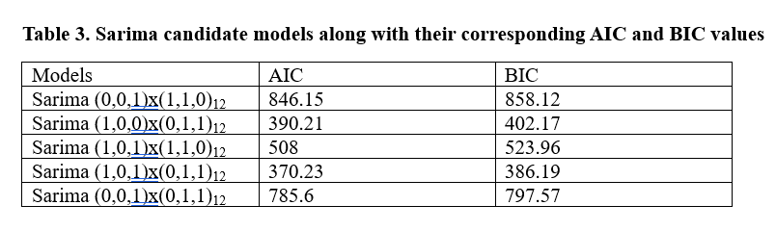

Slide 12
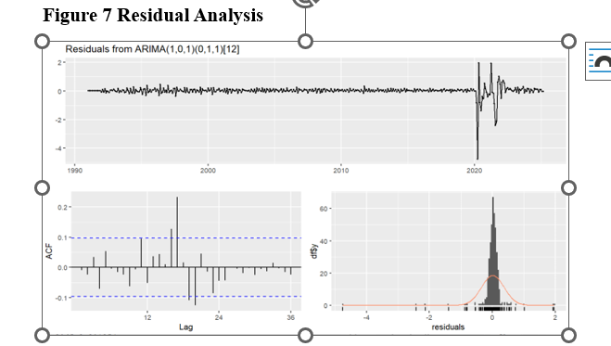

Slide 13
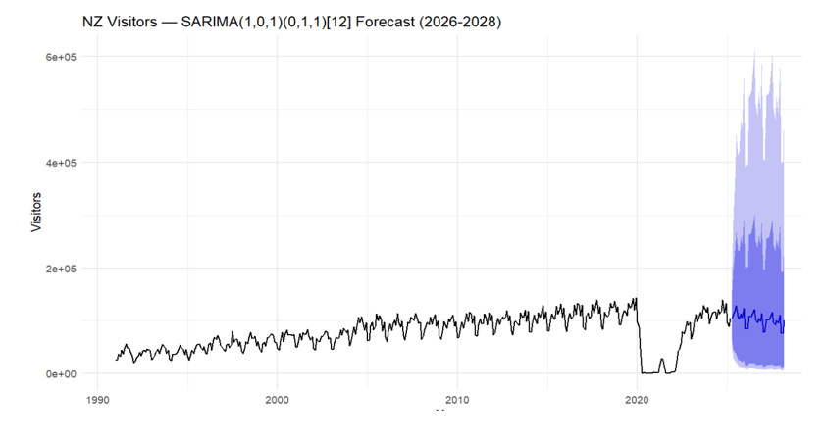

Slide 14
Alternative Approach using Sarimax

Slide 15
Intervention time period
Mar. 2020 – Dec. 2022
(COVID shock)
After covid
Before covid

Slide 16

Reflections
Identify key patterns
Observe key patterns in data and propose models
Learn different simple to advanced forecasting techniques
Statistcal testing to confirm model suitability
Performance measuress

Slide 17

Thank You

